Slide 1
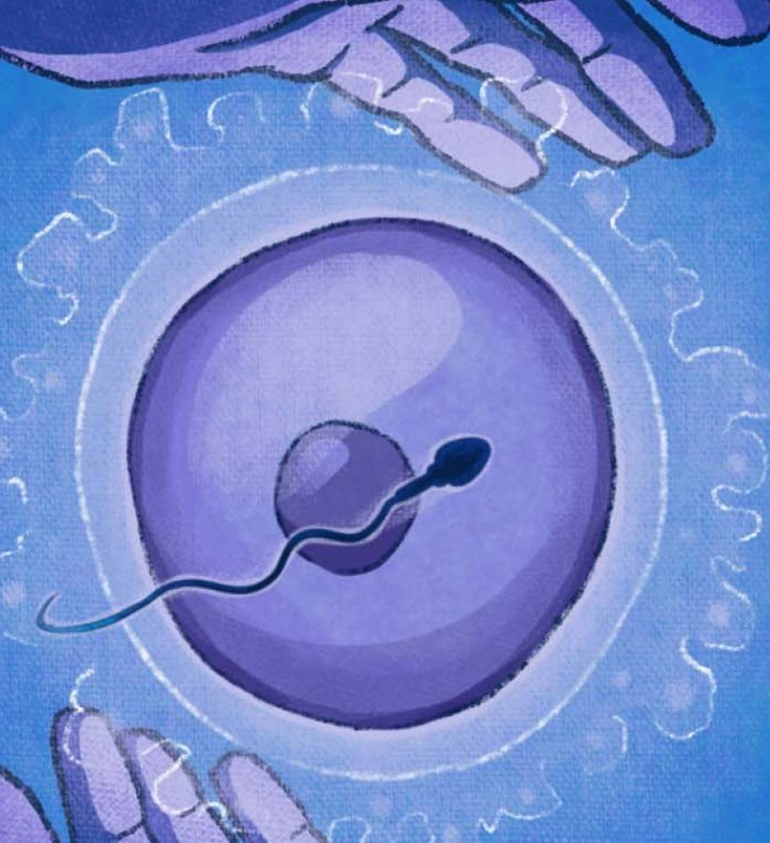
Team Ovulife
SLiCE(Shared Live Client Experience)
PROJECT
PRESENTATION

Slide 2
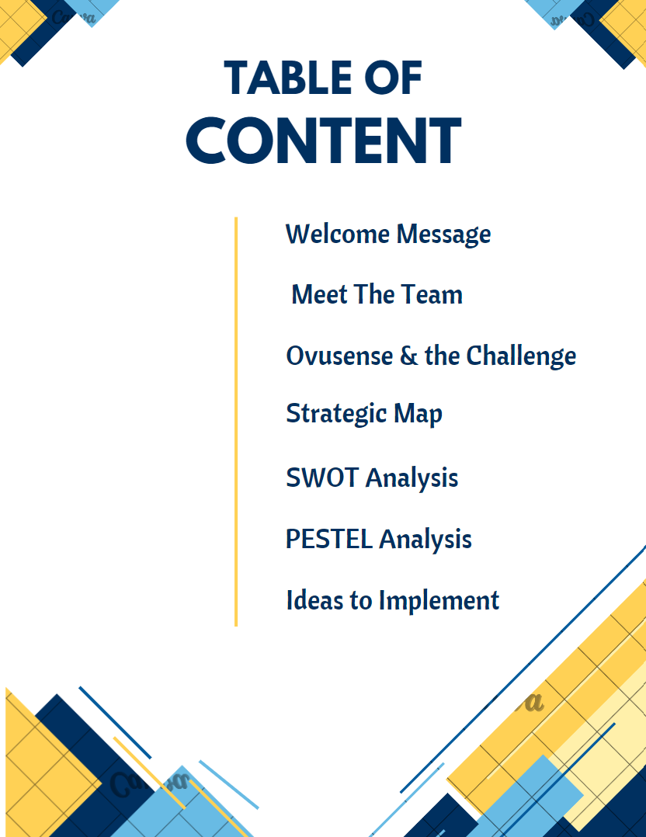
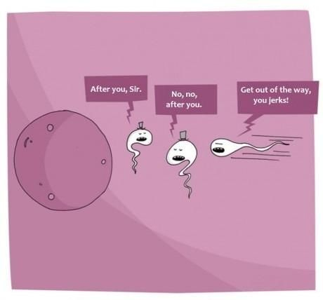
Team Ovulife
Notes:
Trust me, I’m not going to bore you. This is for you.

Slide 3






Group 1: Team Ovulife
Al Aftab Mohammad Shaik
Rajini Ramisetti
Rakesh Velaga
Abdul Khalid
Somesh Katakam
Team Ovulife

Slide 4
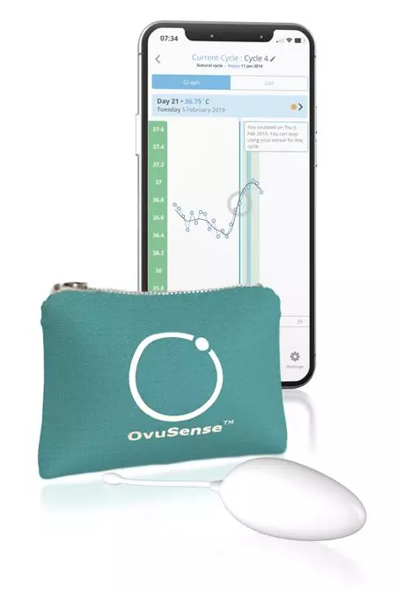
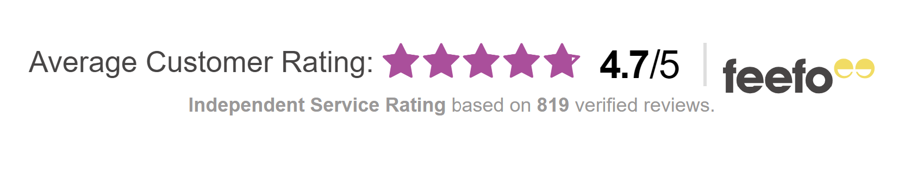
All about Ovusense
Ovusense, fertility monitoring device, help women track their ovulation cycle.
Ovusense Flex, Ovusense advanced fertility monitor.
Ovusense advanced Fertility monitor – Mostly used.
99% Ovulation accuracy.
Average customer rating of 4.7/5
Team Ovulife

Slide 5
Challenge
Spending huge money on advertising
Drive sales.
Customer review -
It typically takes a few minutes to download data from the sensor
Team Ovulife

Slide 6

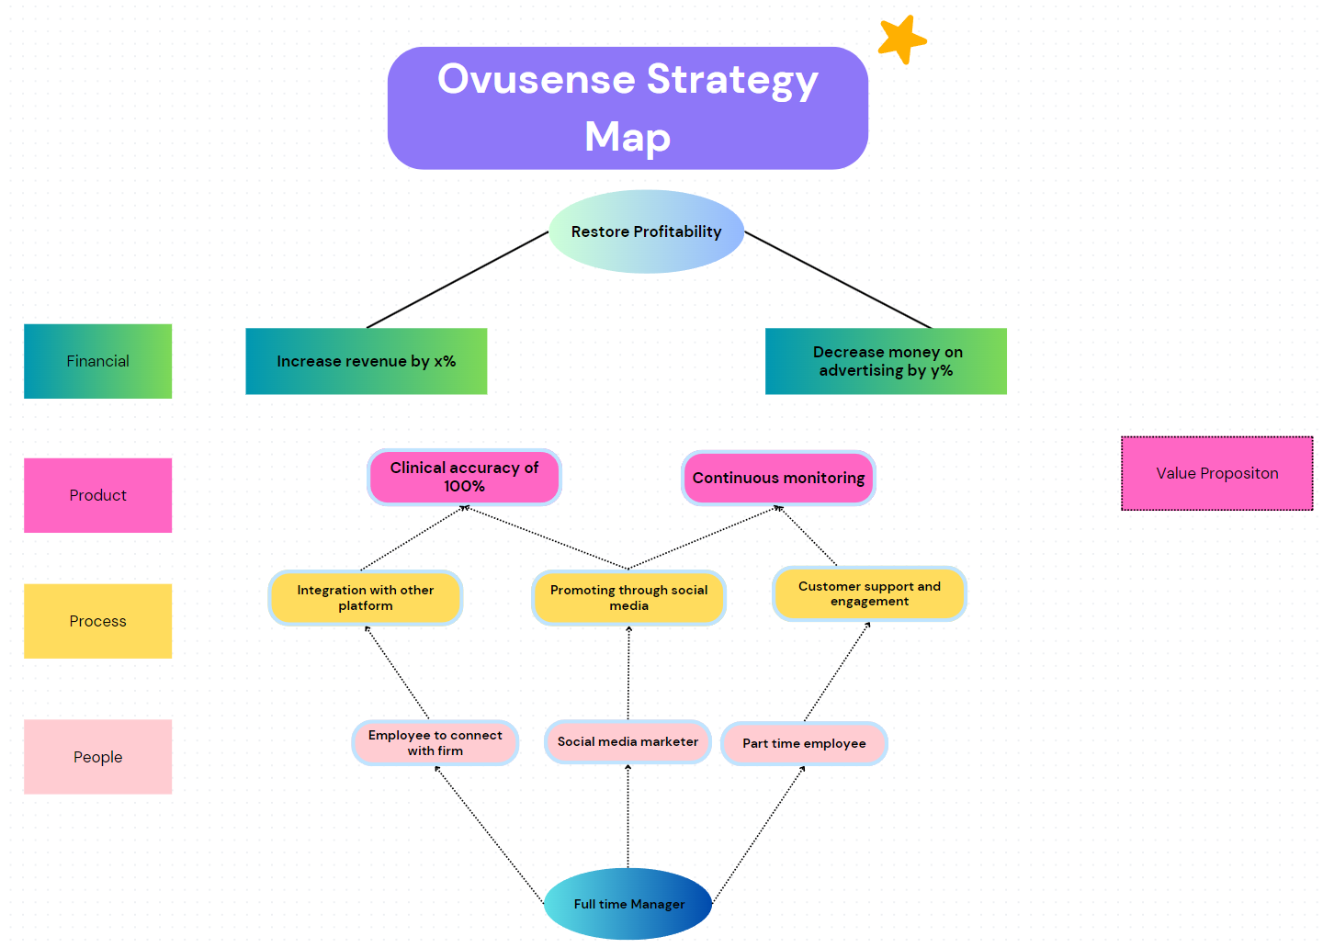

Strategy Map
Team Ovulife
Notes:
2 Primary Goals
To deliver on this promise, they need 3 things, to excel at this process, To make it all these happen. They need.

Slide 7
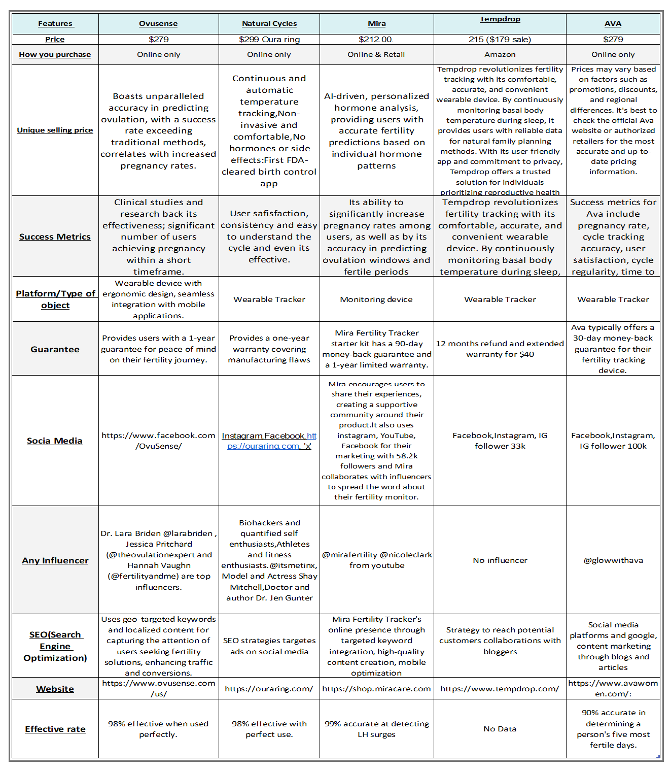
Competitive Grid
Competitive grid help us analyze Ovusense current market competitors, USP, and type of platform they used in everyday operation.
This helps us find areas of improvement.
Team Ovulife

Slide 8
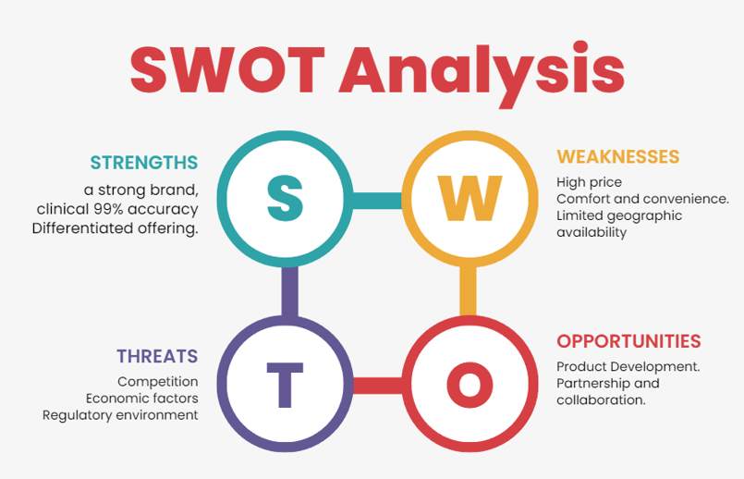
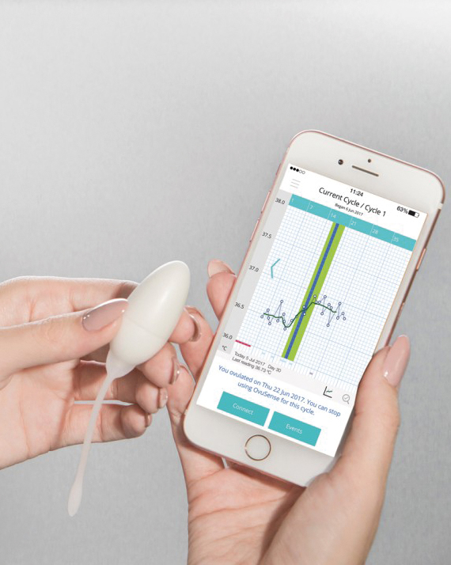
Internal Analysis
Notes:
As per the swot analysis the strengths are their 99% accuracy, and weaknesses are high price and limited geographic availability, and the threats are competition, Economic factors, Regulatory environment and finally opportunities are product development and partnership and collaboration with influencers.

Slide 9
A PESTEL ANALYSIS OF OVUSENSE
We(As a Team) believe that only Economical and Technological factors seems to have a significant impact on the fertility monitor device. Compare to other elements in PESTEL.
ECONOMIC FACTORS:
Recession is a major economic factor, If recession hits, Ovusense may have to change their direction in terms of pricing strategy as consumers have less disposable income to spend and they may go for other fertility devices which are pocket friendly to them.
There is a constant competition in the fertility monitoring devices as this market is growing at a CAGR(Compound annual growth rate) of 7.41% during the forecast period from 2023 to 2028.
TECHNOLOGICAL FACTORS:
Technology is fast moving and has changed drastically over the years. Ovusense uses vaginal sensor to track CBT. So, here Accuracy and Reliability of this sensor technology should be accurately and quickly synced to smartphone devices.
Regular software updates and maintenance are important to address bugs, improve performance and introduce new feature to customers to maintain customer satisfaction.
Notes:
Recession Impact: Recession poses a significant challenge for OvuSense, influencing their pricing strategy. During economic downturns, consumers have less disposable income, potentially leading them to seek more affordable fertility monitoring devices
Market Competition: The fertility monitoring devices market is experiencing steady growth, with a Compound Annual Growth Rate (CAGR) of 7.41% projected from 2023 to 2028. This indicates a highly competitive landscape where OvuSense must continually innovate and differentiate itself to maintain or expand its market share.
Sensor Technology Accuracy: The accuracy and reliability of this sensor technology are paramount, as any inaccuracies could undermine the device's effectiveness and trust among users. Ensuring seamless synchronization with smartphone devices is essential for user convenience and satisfaction.
Software Updates and Maintenance: In the rapidly evolving technological landscape, regular software updates and maintenance are imperative for OvuSense to address bugs, enhance performance, and introduce new features. This proactive approach not only improves the user experience but also demonstrates OvuSensecommitment to customer satisfaction and technological advancement.

Slide 10
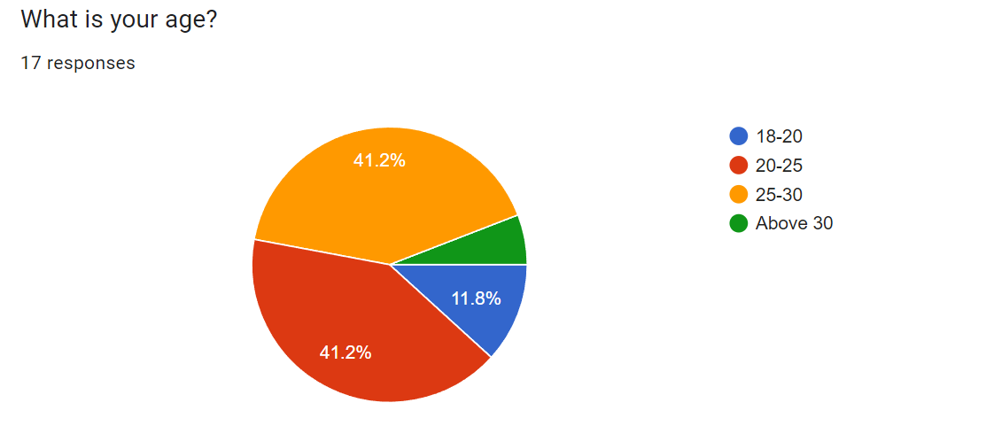
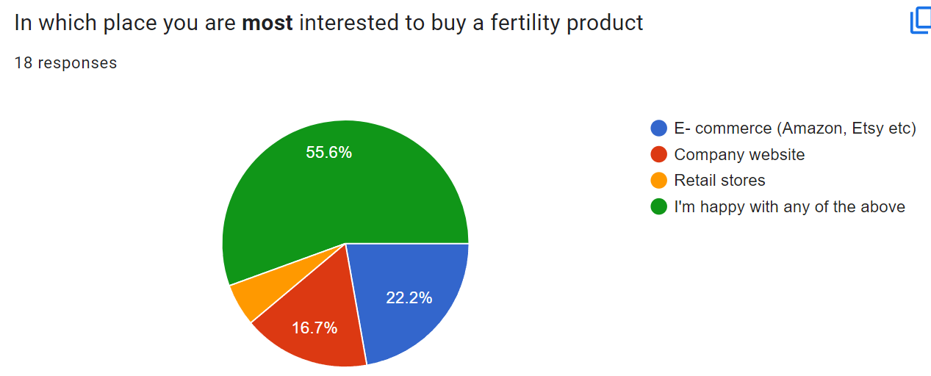
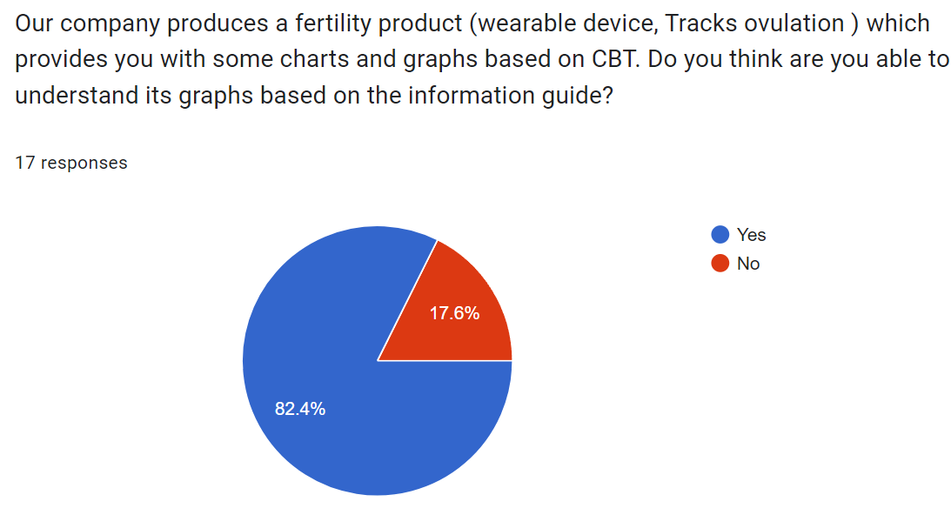
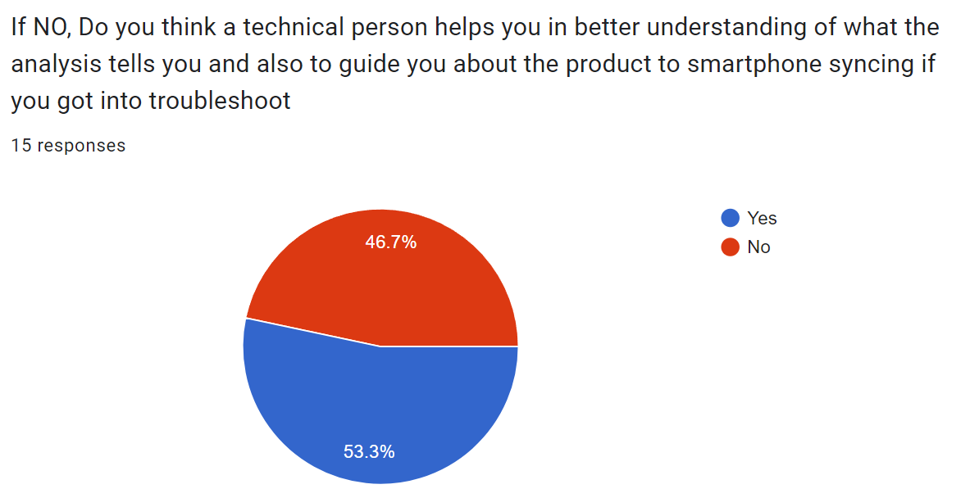
Survey on Fertility Product
Customers are ready to purchase in any of the channels.
There is a 50 – 50 chance.
Information guide is fine.

Slide 11
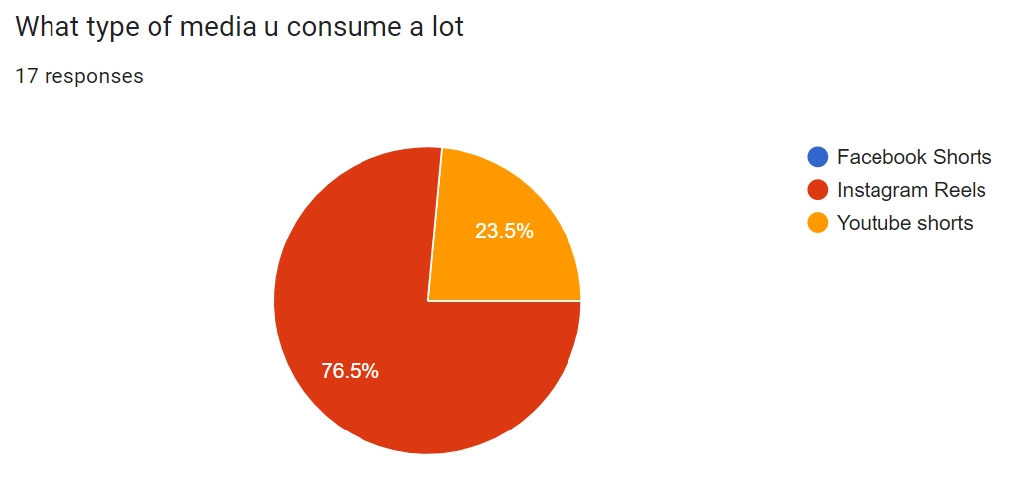
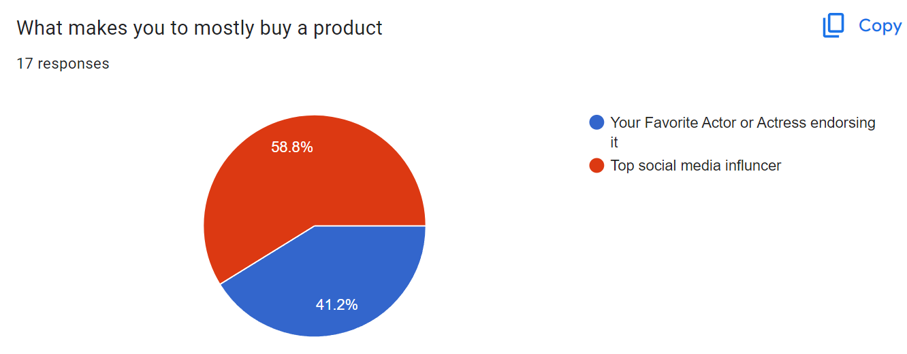
Survey on Fertility Product
Our focus should be on Instagram reels.
Choosing Influencer over celebrities

Slide 12
Idea 1 : Product Innovation
Global market for fertility tracker accounts for USD 16.18 Billion in 2022. The market is anticipated to grow and surpass a valuation of USD 44.72 Billion by 2032. As said earlier, it is expected to grow with a CAGR of 10.7% in the forecast period.
Personalized health insights (Tailored nutrition and exercise plans based on individual dietary preferences)
Real time health alerts
Without leaving the interpretation of hormone value to users, Our apps should determine if the fertility for that day is lower or higher.
Developing a Bluetooth sensor so that it eliminates physical connection of sensor to the mobile device.
Introducing real-time feature that provide insight and recommendation to user for optimal intercourse timing, lifestyle adjustment.
Integrating with Telemedicine platform to enable virtual consultation with fertility specialist directly via Ovusense app.
Enhancing the visualization of Ovusense data graphically which makes them better understand their fertility patterns.
Team Ovulife

Slide 13
Idea 2 : Social Media Marketing
Reels – Creating a short, engaging video maximizing fertility tracking success, hashtags to increase discoverability.
Influencer Partnership – Collaborating with influencers by sharing their experience using Ovusense by showcasing ovulation happened in their smartphones.(Not just promoting the Ovusense product)
Behind-the-scenes sneak peeks – Offer behind the scene glimpse into Ovusense product development process, customer support team, company culture to humanize the brand.
FAQ Shorts – Addressing frequently asked questions about Ovusense and fertility tracking in short, concise videos.
Success Story Highlights – Sharing Inspiring success stories of Ovusense users who have achieved pregnancy or improved their fertility journey with the help of device.
Team Ovulife
Notes:
-Create Reels showing why ovulation tracking is important and how OvuSense makes it easy. Use eye-catching visuals and text to emphasize accuracy and convenience,
by using Reels effectively, you can not only raise awareness about OvuSense but also establish your brand as a trusted resource for fertility tracking and support.
-Provide glimpses behind the scenes of OvuSense, showcasing the team, development process, or technology. Humanize the brand and deepen audience connection by revealing the people and processes behind the product.
-addressing FAQ shorts for OvuSense is a strategic way to provide clarity, build trust, streamline customer support, educate your audience, and boost conversion rates.
-"Success Story Highlights" of OvuSense are collections of real testimonials from users who've successfully used the system to track ovulation and achieve their family planning goals,

Slide 14
References
https://pro.similarweb.com/#/digitalsuite/home
https://www.semrush.com/projects/
https://www.ovusense.com/us/advanced-fertility-monitor/
https://www.tempdrop.com/
https://www.miracare.com/
https://www.avawomen.com/
https://www.naturalcycles.com/
Team Ovulife

Slide 15
